Slide 1
Deposit Tracker
- Team members:
Abdalla Kamal Kandil
Mahmoud Hamaky
Hossam Sameh

Slide 2
THE aim of the app:
Calculation of the bank’s deposits and track the increase day by day

Slide 3
Input DATA:
Banks’ names
The amount of money
The annual rate
The number of years
The date of deposit assign

Slide 4
Output DATA:
Total balance after several years for all bank accounts
Total balance on the chosen date
Details of the deposits

Slide 5
Android Version

Slide 6

App Icon

Slide 7
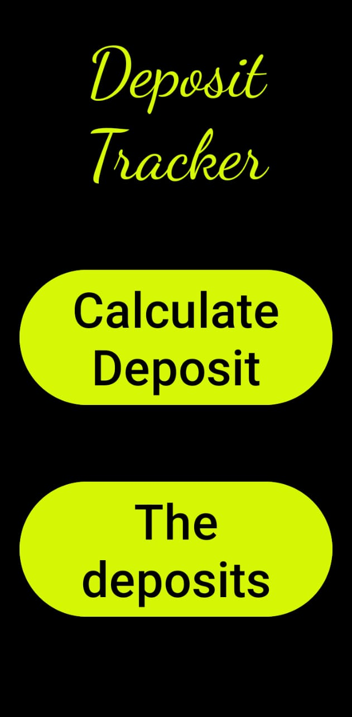

Slide 8
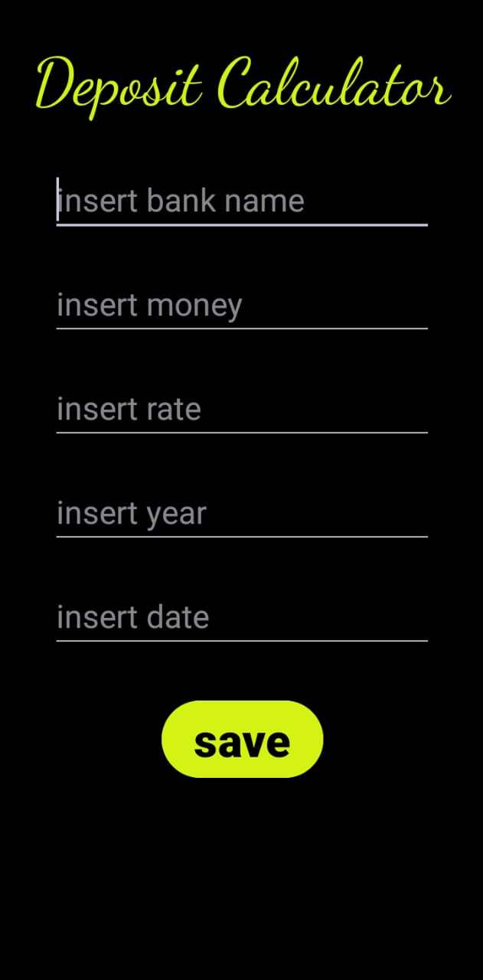

Slide 9
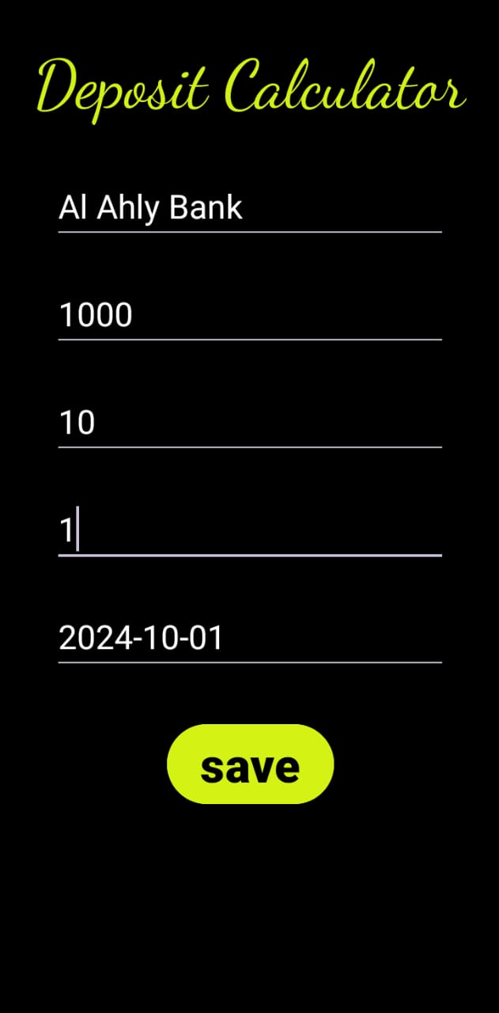

Slide 10
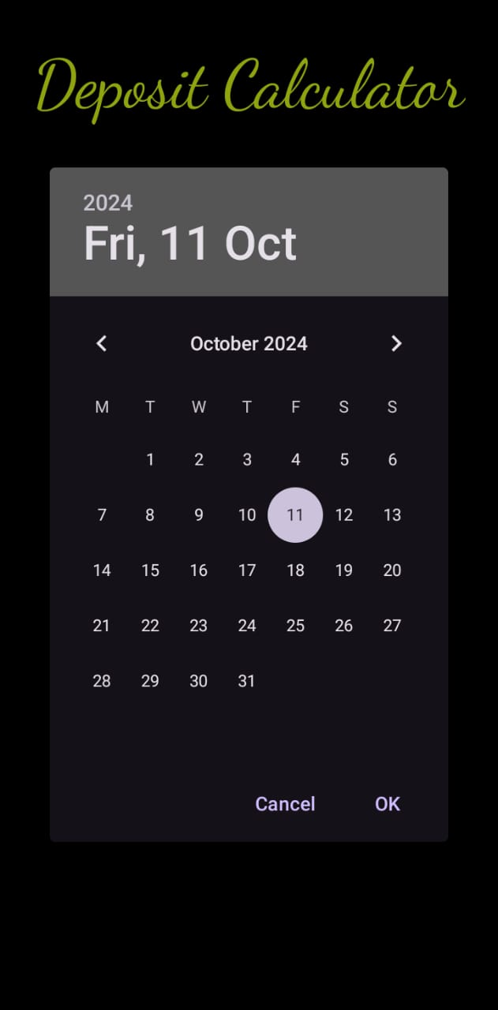

Slide 11
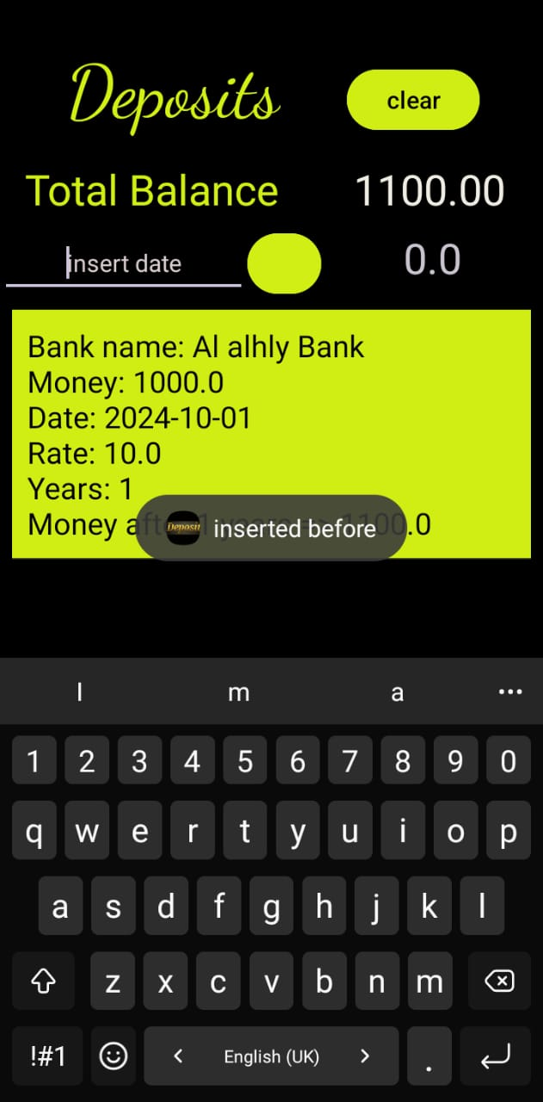

Slide 12
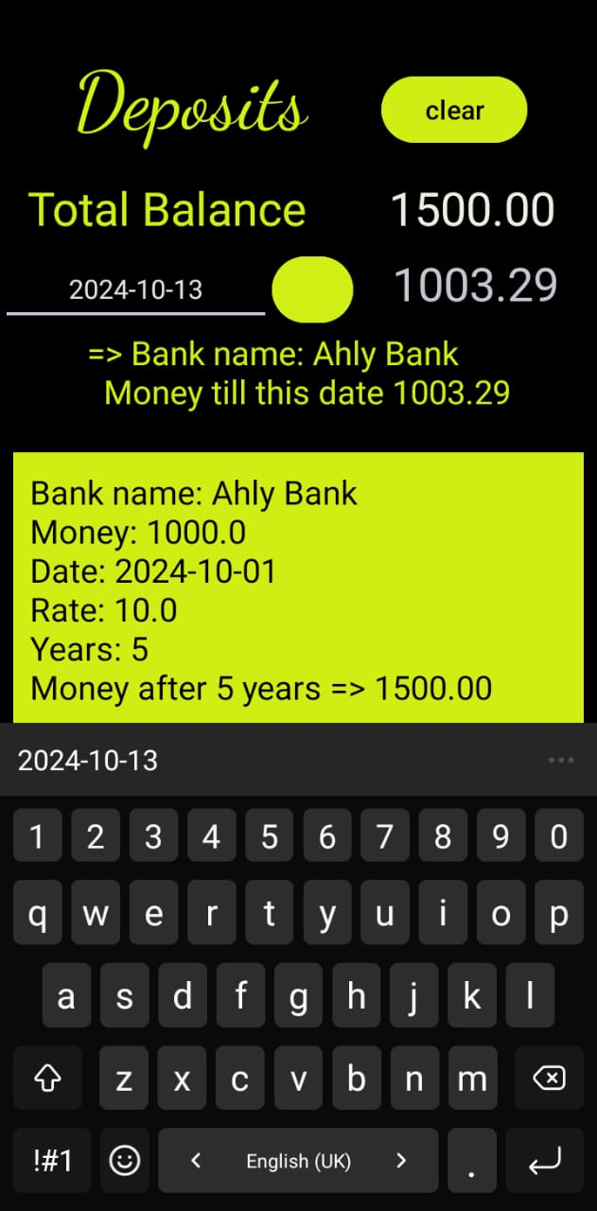

Slide 13
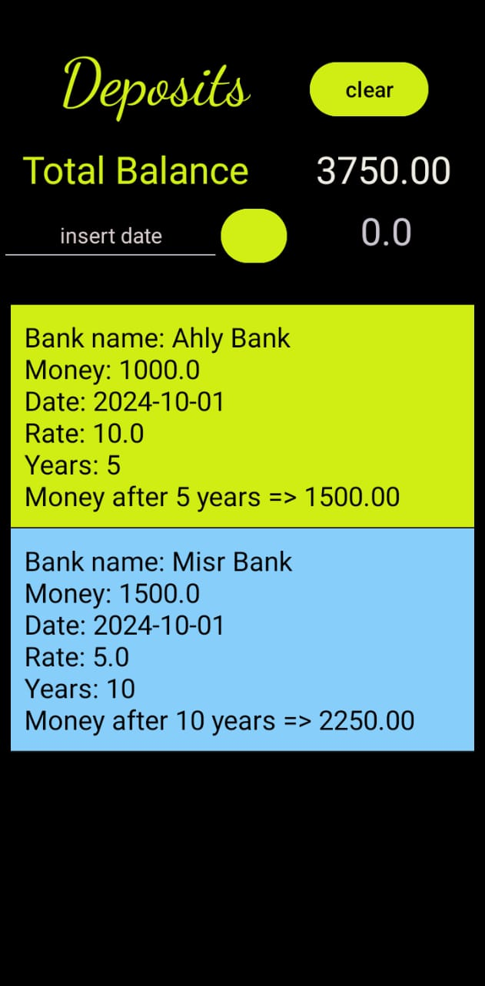

Slide 14
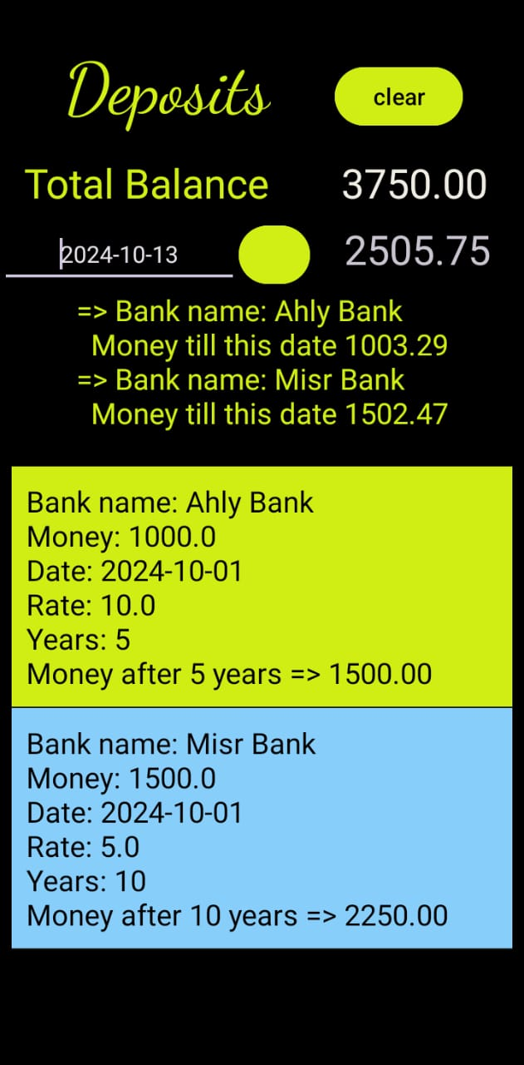

Slide 15
Flutter VERSION

Slide 16
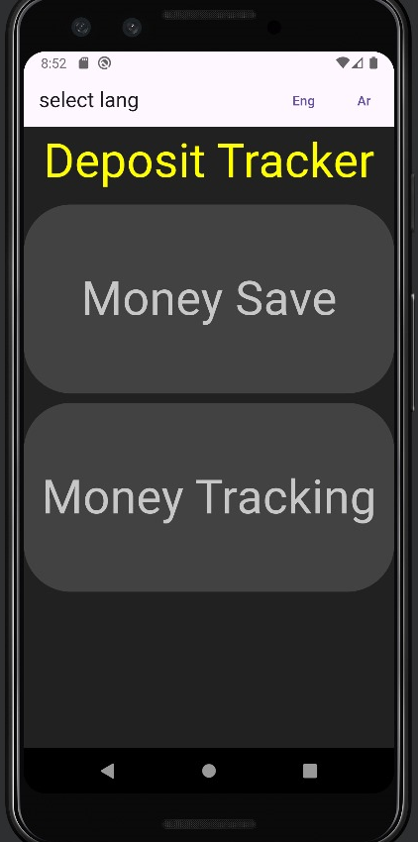

Slide 17
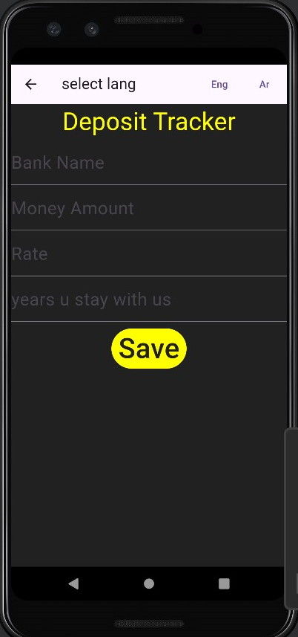

Slide 18
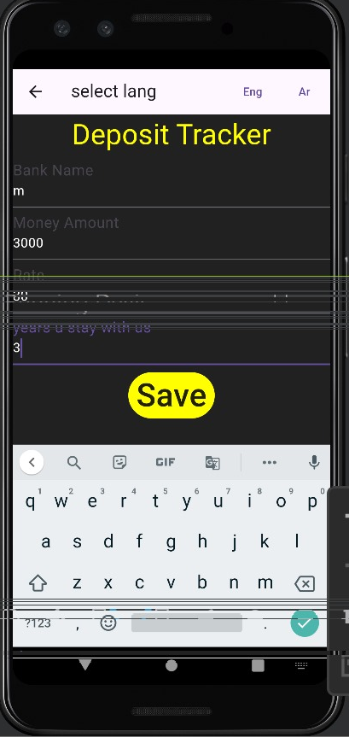

Slide 19
